Slide 1
Microservices
Brijendra Singh

Slide 2
Traditional Monolithic Applications
Industry uses the term monolithic to characterize an application constructed as a single, self contained piece of software. Monolithic applications tend to be both large and complex.
Internally, they contain code to perform many functions that can span a wide range.

Slide 3
Example of a monolithic application
Consider an application program that provides an online shopping service.
To access the service, a user launches a browser and enters the URL of the service, which connects to the application in question.
The application allows the user to select items, specify shipping, enter payment information, and rate the experience.
Internally, a monolithic application must contain the code needed to handle each of the steps, including code to search the catalog of products, code to access the customer database, the payment processing system, and so on.

Slide 4
Example of a monolithic application
The code is organized into a main program plus a set of functions (which are known as methods). Next figure illustrates the idea.

Slide 5
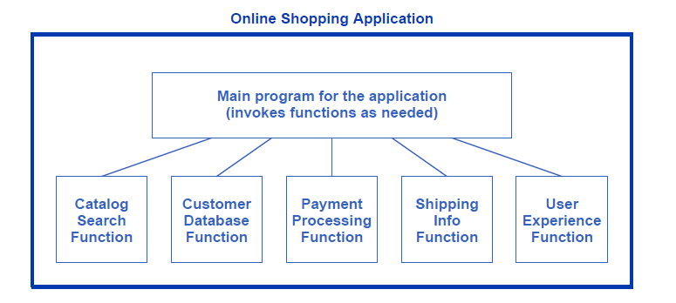
Illustration of a monolithic application with all the functions needed to support online shopping built into a single program.

Slide 6
Monolithic Applications In A Data Center
Can a traditional monolithic application run in a data center? Yes.
A tenant can launch and use a VM to run monolithic applications, exactly the way they run on a traditional server.
However, software engineers have pointed out that the monolithic approach has some disadvantages and an alternate approach may be better for a cloud environment.
In particular, monolithic applications cannot be replicated as quickly as cloud-native applications. First, starting a VM has higher overhead than starting a container. Second, a monolithic design means all code must be downloaded when the application starts, even if pieces are not used.

Slide 7
Monolithic Applications In A Data Center
To understand why downloading code causes unnecessary overhead, consider the shopping example and remember that many cloud systems handle scale by creating copies of an application as needed and allowing the copies to expire when they complete.
In the case of online shopping, many users peruse a catalog without logging in, without making a purchase or arranging shipping, and without filling out the experience questionnaire.
For such customers, the application only invokes the catalog search function; code for other functions must be downloaded, but is not used.

Slide 8
The Microservices Approach
The microservices approach to software, sometimes called a microservices architecture, divides functionality into multiple, independent applications. Each of the independent applications is much smaller than a monolithic program, and only handles one function.
To perform a task, the independent applications communicate over a network.

Slide 9
The Microservices Approach
The microservices approach can be used in two ways:to implement a new application or to divide an existing monolithic application.
We use the term disaggregation to refer to the division of a monolithic application into microservices. Next figure illustrates one possible way to disaggregate the monolithic online shopping application.

Slide 10
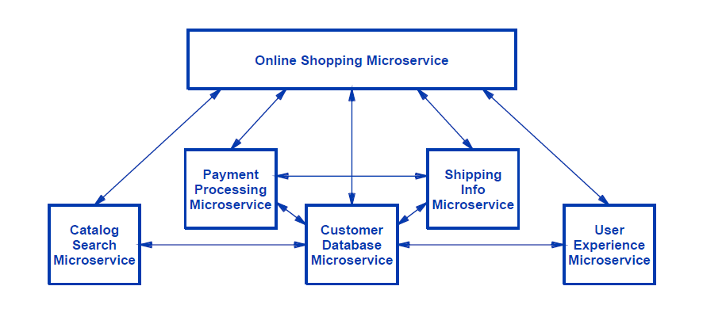
Illustration of the shopping application disaggregated into a set of microservices that communicate with one another

Slide 11
The Advantages Of Microservices-Advantages For Software Development
The microservices approach offers several advantages for software development:
Smaller scope and better modularity
The limited scope encourages better decomposition and allows engineers to understand each piece completely.
Smaller teams
Each microservice only requires a small development team, meaning that the resulting code will be more uniform and less prone to errors.

Slide 12
The Advantages Of Microservices-Advantages For Software Development
Less complexity
The microservices approach eliminates global variables, and requires designers to document the exact interfaces among piece of codes.
Choice of programming language
Software engineers can choose the best language for individual service.
More extensive testing
Each service can be tested independently, allowing more extensive and thorough assessment.

Slide 13
The Advantages Of Microservices -Advantages For Operations And Maintenance
The microservices approach also offers operational advantages:
Rapid deployment
Because each service is small, the microservices approach means a given microservice can be created, tested, and deployed rapidly.
Improved fault isolation
Dividing an application into multiple microservices makes fault isolation easier. When a problem occurs, a manager can identify and test the misbehaving microservice while allowing applications and other microservices to continue normal operations.

Slide 14
The Advantages Of Microservices -Advantages For Operations And Maintenance
Better control of scaling
Each microservice can be scaled independently.
Compatibility with containers and orchestration systems
A key distinction between the monolithic approach and the microservices approach arises from the underlying platforms needed. Because it is small and only performs one task, a microservice fits best into the container paradigm. Furthermore, using containers means that microservices can be monitored, scaled, and load balanced by a conventional container orchestration system, such as Kubernetes.
Notes:
Containers are packages of software that contain all of the necessary elements to run in any environment. In this way, containers virtualize the operating system and run anywhere, from a private data center to the public cloud or even on a developer's personal laptop.
While Docker is a container runtime, Kubernetes is a platform for running and managing containers from many container runtimes. Kubernetes supports numerous container runtimes including Docker

Slide 15
The Advantages Of Microservices- Advantages For Operations And Maintenance
Independent upgrade of each service
Once an improved version of a microservice has been created, the new version can be introduced without stopping existing applications and without disturbing other microservices.

Slide 16
The Potential Disadvantages Of Microservices
Although it offers many advantages,the microservices approach also has potential disadvantages, including:
Cascading errors
One of the advantages of a monolithic application lies in the property of being self-contained. If a function contains an error, the application may fail, but other applications will continue. In the microservices approach, one microser- vice can invoke another, which can invoke another, and so on. If one of the microser- vices fails, the failure may affect many others as well as the applications that use them.

Slide 17
The Potential Disadvantages Of Microservices
Duplication of functionality and overlap
Interestingly, the ease with which microservices can be created invites software engineers to deploy many. For example, some large enterprises report having hundreds of microservices deployed. When functionality is needed that differs slightly from an existing microservice, it is often easier to create a completely new one than to modify the existing microservice.
Management complexity
Each microservice must be monitored and managed. Microservices make management more complex. Although orchestration and automation tools help, with hundreds of microservices running simultaneously, it can be difficult for a manager to understand their behaviors, interdependencies, and the interactions among them.

Slide 18
The Potential Disadvantages Of Microservices
Replication of data and transmission overhead
Recall that the monolithic approach allows functions to share global data, Although it can lead to problems, sharing has the advantage of efficiency, especially in cases where functions access large sets of data. The microservices approach requires each microservice to obtain a copy of the needed data, either from a storage server or by being passed a copy when the microservice is invoked. More important, an application that invokes many microservices may experience excessive overhead if each of the microservices needs to access the data.

Slide 19
The Potential Disadvantages Of Microservices
Increase security attack surface
We use the term security attack surface to refer to the points in a system that can be used to launch an attack. A monolithic application represents a single attack point.
By disaggregating an application into many indepen- dent pieces, the microservices approach creates multiple points that an attacker can try to exploit.

Slide 20
The Potential Disadvantages Of Microservices
Workforce training
When following the monolithic approach, a software engineer divides the code into modules that make the application easy to create and maintain.
In contrast, the microservices approach requires software engineers to consider the cost of running each microservice as well as the communication costs incurred in accessing data or passing it from one microservice to another.
A software engineer must also consider the question of granularity. Thus, software engineers need new skills to create software for microservices.

Slide 21
Communication Protocols Used For Microservices
To have meaningful and unambiguous communication, both sides must agree on the format and meaning of messages that are exchanged; communication protocols specify the message details.
Like other applications in a data center, microservices communicate using Internet protocols. Doing so means a microservice can be reached from inside or outside the data center, subject to security restrictions.

Slide 22
Communication Protocols Used For Microservices
For the transport layer protocol, most microservices use the Transmission Control Protocol (TCP), with TCP being sent in Internet Protocol (IP) packets.
Although a software engineer can design a special-purpose transfer protocol for each new microservice, most engineers choose from among existing transfer protocols. Using an existing protocol makes it easier to write code. Several transfer protocols ex- ist and satisfy most needs.

Slide 23
Communication Protocols Used For Microservices
HTTP
When an entity uses HTTP to communicate with a microservice, data can flow in either direction. That is, the entity can send data to the microservice or request that the microservice send data.

Slide 24
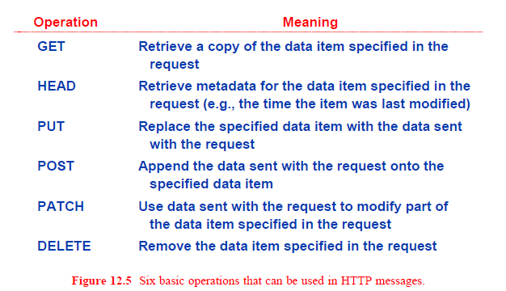

Slide 25
Communication Protocols Used For Microservices
gRPC
Unlike most transfer protocols, gRPC does not define a specific set of operations that can be performed. Instead, it provides a general framework for communication and allows a specific set of operations to be defined for each instance (i.e., for each microservice).

Slide 26
Communication Among Microservices
A variety of interactions have been used with microservices. The interactions can be divided into two broad types:
Request-response (RESTinterface)
Data streaming (continuous interface)

Slide 27
request-response
Software engineers use the term REST or RESTful† to describe the request-response style of interaction use d on the Web: a web browser sends a request to which a web server responds.
A microservice that uses request-response interaction follows the same pattern of accepting a request and returning a response. Any further interaction between the microservice and the entity using the microservice re- quires another request. Saying that a microservice uses a REST API usually implies that the microservice uses HTTP as its transfer protocol.

Slide 28
Data Streaming
A major disadvantage of request-response interaction arises in cases when a microservice needs to return many items in response to a request. To adhere to the request-response approach, the entity using the microservice must make repeated requests. Of course, a microservice can combine a small number of items into a single response (e.g., by sending the equivalent of a zip file).

Slide 29
Data Streaming
However, all items must be available, and the processing required to create the combined response must be reasonable. Data streaming interaction avoids repeated requests by allowing the microservice to provide a stream of data items as a response.
When using a streaming interface, an entity establishes a network connection with the microservice and sends a single request. The microservice sends a sequence of one or more data items in response to the request (i.e., the microservice streams a sequence of data items).

